Slide 1
Primary Research Methods
Sanjay Fuloria

Slide 2
Agenda for the day
Difference between Primary and Secondary Research
Different Primary Research Options
Questionnaires
Sampling
Evaluating the quality of measures
Interviews
Analysis Techniques

Slide 3
The Difference between...
Primary Research
New and original - no one's done it before
Usually has a specific purpose
Secondary Research
Research done by somebody else
One resource won’t be enough to answer your question
Back

Slide 4
Good primary research leads to…
Assessment Objectives | Mark Band | Assessment Criteria
Obtain and select from a variety of resources Analyze Data Apply information relevantly Demonstrate understanding of appropriate links | 7-10 Marks | Evidence of detailed research involving the selection and evaluation of a wide range of relevant resources. Critical analysis and application of the resources with clear links made to appropriate theories and concepts.
 | 4-6 Marks | Evidence of some research involving the selection and evaluation of a range of relevant resources. Some analysis and application of research with links made to appropriate theories and concepts.
 | 1-3 Marks | Evidence of limited research involving limited selection and evaluation of resources. Little or no analysis and application of the resources with few links made to appropriate theories and concepts.
 | 0 Marks | No relevant response.

Slide 5
Your report
Abstract/Introduction
Literature Review
Methodology
Results
Discussion
Conclusion
Appendices/Bibliography etc
Primary research discussed/analysed here

Slide 6


Different Primary Research options…
Questionnaires
Interviews
Focus Groups
Field Notes, Videos, Recordings etc
Case Studies
Back
Two most common ones

Slide 7
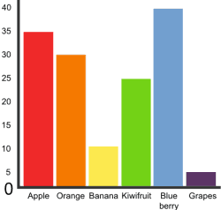
Questionnaires
Provide Quantitative Data – data that can be measured
Tick boxes and, mostly, no more than a few words per answer
Most useful if you want to test an existing theory or take a sample of general thoughts
Back

Slide 8
Formulating questions
Objective-Status of automation in the healthcare industry
What best describes the current stage of your organization’s automation initiative?
Fully deployed live application
Testing proof of concept/ pilot
Developed MVP (minimum viable product)/Demo/Prototype)
Identified use cases
Nothing currently, but may start in near future
No plans for automation

Slide 9
Another question….
What is most significant benefit you want to achieve through automation?)
Seamless customer experience
Reduced risk
Cost saving
Generate investment money from cost saving
Competition
Free FTE for other productive area
Service level efficiency
Any Other -------------------

Slide 10
Sampling
A sample is “a smaller (but hopefully representative) collection of units from a population used to determine truths about that population” (Field, 2005)
Why sample?
Resources (time, money) and workload
Gives results with known accuracy that can be calculated mathematically
The sampling frame is the list from which the potential respondents are drawn
Registrar’s office
Class rosters
Must assess sampling frame errors
Back

Slide 11
3 factors that influence sample representative-ness
Sampling procedure
Sample size
Participation (response)
When might you sample the entire population?
When your population is very small
When you have extensive resources
When you don’t expect a very high response

Slide 12
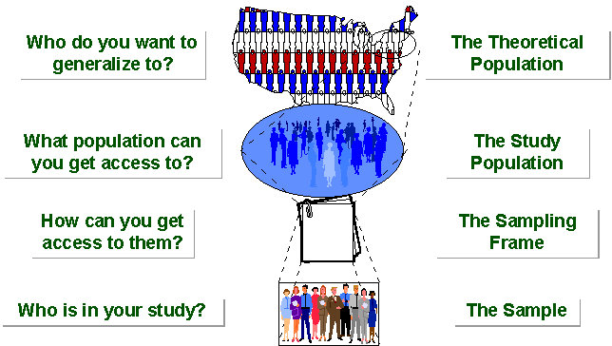
SAMPLING BREAKDOWN
Notes:
Picture of sampling breakdown

Slide 13
Types of Samples
Probability (Random) Samples
Simple random sample
Systematic random sample
Stratified random sample
Multistage sample
Multiphase sample
Cluster sample
Non-Probability Samples
Convenience sample
Purposive sample
Quota
Notes:
Systematic sampling is a type of probability sampling method in which sample members from a larger population are selected according to a random starting point and a fixed, periodic interval. This interval, called the sampling interval, is calculated by dividing the population size by the desired sample size. Despite the sample population being selected in advance, systematic sampling is still thought of as being random if the periodic interval is determined beforehand and the starting point is random.
Stratified random sampling is a method of sampling that involves the division of a population into smaller groups known as strata. In stratified random sampling, or stratification, the strata are formed based on members' shared attributes or characteristics.
Stratified random sampling divides a population into subgroups or strata, and random samples are taken, in proportion to the population, from each of the strata created. The members in each of the stratum formed have similar attributes and characteristics. ... A simple random sample should be taken from each stratum.
Multistage sampling can be a complex form of cluster sampling because it is a type of sampling which involves dividing the population into groups (or clusters). Then, one or more clusters are chosen at random and everyone within the chosen cluster is sampled.
Using all the sample elements in all the selected clusters may be prohibitively expensive or unnecessary. Under these circumstances, multistage cluster sampling becomes useful. Instead of using all the elements contained in the selected clusters, the researcher randomly selects elements from each cluster. Constructing the clusters is the first stage. Deciding what elements within the cluster to use is the second stage. The technique is used frequently when a complete list of all members of the population does not exist and is inappropriate.
In some cases, several levels of cluster selection may be applied before the final sample elements are reached. For example, household surveys conducted by the Australian Bureau of Statistics begin by dividing metropolitan regions into 'collection districts' and selecting some of these collection districts (first stage). The selected collection districts are then divided into blocks, and blocks are chosen from within each selected collection district (second stage). Next, dwellings are listed within each selected block, and some of these dwellings are selected (third stage). This method makes it unnecessary to create a list of every dwelling in the region and necessary only for selected blocks. In remote areas, an additional stage of clustering is used, in order to reduce travel requirements.^{[2]}
A multiphase sampling is a sampling procedure in which it collects some information from thewhole unit sample and additional information also is collected, at the same time or by later.Usually the additional information is collected to provide more detail information about thesample. The multiphase sampling is nown as “two!phase sampling” where double or more phase sampling procedures can be done in at the same time or by later. The first sampling is tocollect “basic information” from a large sample of unit and then followed by the secondsampling collects more about “detailed information”. This ind of technique can be used ashandful way to resolve the issue of the insufficient budget to collect entire information about thewhole population or even creating an e"cessive burden toward the respondent to answer the question.
Cluster Sample- Cluster sampling refers to a type of sampling method . With cluster sampling, the researcher divides the population into separate groups, called clusters. Then, a simple random sample of clusters is selected from the population. The researcher conducts his analysis on data from the sampled clusters.
For example, a researcher wants to survey academic performance of high school students in Spain. He can divide the entire population (population of Spain) into -different clusters (cities). Then the researcher selects a number of clusters depending on his research through simple or systematic random sampling.
Non-Probability Samples-Convenience Sample-Convenience sampling is a type of nonprobability sampling in which people are sampled simply because they are "convenient" sources of data for researchers. In probability sampling, each element in the population has a known nonzero chance of being selected through the use of a random selection procedure.
A purposive sample is a non-probability sample that is selected based on characteristics of a population and the objective of the study. Purposive sampling is also known as judgmental, selective, or subjective sampling.
Purposive Sampling (Deliberate Sampling) A purposive sample is where a researcher selects a sample based on their knowledge about the study and population. ... Participants are selected according to the needs of the study (hence the alternate name, deliberate sampling); applicants who do not meet the profile are rejected
Quota Sampling-A sampling method of gathering representative data from a group. As opposed to random sampling, quota sampling requires that representative individuals are chosen out of a specific subgroup. For example, a researcher might ask for a sample of 100 females, or 100 individuals between the ages of 20-30.
The main difference between cluster sampling andstratified sampling is that in cluster sampling thecluster is treated as the sampling unit so samplingis done on a population of clusters (at least in thefirst stage). In stratified sampling, the sampling is done on elements within each strata.

Slide 14
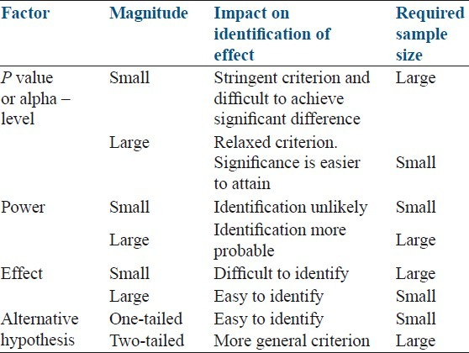
Sample Size
Notes:
Power refers to the probability that your test will find a statistically significant difference when such a difference actually exists. In other words, power is the probability that you will reject the null hypothesis when you should (and thus avoid a Type II error). It is generally accepted that power should be .8 or greater; that is, you should have an 80% or greater chance of finding a statistically significant difference when there is one.
What is effect size?
When a difference is statistically significant, it does not necessarily mean that it is big, important, or helpful in decision-making. It simply means you can be confident that there is a difference. Let’s say, for example, that you evaluate the effect of an EE activity on student knowledge using pre and posttests. The mean score on the pretest was 83 out of 100 while the mean score on the posttest was 84. Although you find that the difference in scores is statistically significant (because of a large sample size), the difference is very slight, suggesting that the program did not lead to a meaningful increase in student knowledge.
To know if an observed difference is not only statistically significant but also important or meaningful, you will need to calculate its effect size. Rather than reporting the difference in terms of, for example, the number of points earned on a test or the number of pounds of recycling collected, effect size is standardized. In other words, all effect sizes are calculated on a common scale -- which allows you to compare the effectiveness of different programs on the same outcome.
How do I calculate effect size?
There are different ways to calculate effect size depending on the evaluation design you use. Generally, effect size is calculated by taking the difference between the two groups (e.g., the mean of treatment group minus the mean of the control group) and dividing it by the standard deviation of one of the groups. For example, in an evaluation with a treatment group and control group, effect size is the difference in means between the two groups divided by the standard deviation of the control group.
mean of treatment group – mean of control group
standard deviation of control group
To interpret the resulting number, most social scientists use this general guide developed by Cohen:
Interpretation of the effect size-
< 0.1 = trivial effect
0.1 - 0.3 = small effect
0.3 - 0.5 = moderate effect
> 0.5 = large difference effect

Slide 15
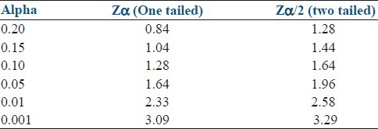

Slide 16
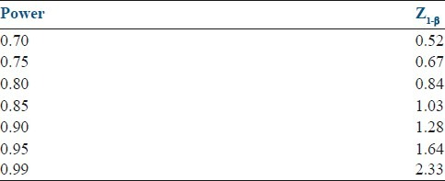

Slide 17
The “outcome” expected under study should be considered.
There are 3 possible categories of outcome.
The first is a simple case where 2 alternatives exist: Yes/no, death/alive, vaccinated/not vaccinated, etc.
The second category covers multiple, mutually exclusive alternatives such as religious beliefs or blood groups. For these 2 categories of outcome, the data are generally expressed as percentages or rates[5–7] The third category covers continuous response variables such as weight, height, blood pressure, VAS score, IL6, TNF-a, homocysteine etc, which are continuous measures and are summarized as means and standard deviations. The statistical methods appropriates the sample size based on which of these outcomes measure is critical for the study, for example, larger sample size is required to assess the categorical variable compared to continuous outcome variable.

Slide 18
Alpha level
The definition of alpha is the probability of detecting a significant difference when the treatments are equally effective or risk of false positive findings. The alpha level used in determining the sample size in most of academic research studies are either 0.05 or 0.01.[7] Lower the alpha level, larger is the sample size. For example, a study with alpha level of 0.01 requires more subjects when compared to a study with alpha level of 0.05 for similar outcome variable. Lower alpha viz 0.01 or less is used when the decisions based on the research are critical and the errors may cause substantial, financial, or personal harm.

Slide 19
Variance or standard deviation
The variance or standard deviation for sample size calculation is obtained either from previous studies or from pilot study. Larger the standard deviation, larger is the sample size required in a study. For example, in a study, with primary outcome variable is TNF-a, needs more subjects compared to a variable of birth weight, 10-point Vas score etc. as the natural variability of TNF-a is wide compared to others.

Slide 20
Minimum detectable difference
This is the expected difference or relationship between 2 independent samples, also known as the effect size. The obvious question is how to know the difference in a study, which is not conducted. If available, it may be useful to use the effect size found from prior studies. Where no previous study exists, the effect size is determined from literature review, logical assertion, and conjecture.

Slide 21
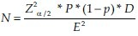
D is the design effect reflects the sampling design used in the survey type of study.
This is 1 for simple random sampling and higher values (usually 1 to 2) for other designs such as stratified, systematic, cluster random sampling etc, estimated to compensate for deviation from simple random sampling procedure. The design effect for cluster random sampling is taken as 1.5 to 2. For the purposive sampling, convenience or judgment sampling, D will cross 10. Higher the D, the more will be sample size required for a study. Simple random sampling is unlikely to be the sampling method in an actual filed survey. If another sampling method such as systematic, stratified, cluster sampling etc. is used, a larger sample size is likely to be needed because of the “design effect”

Slide 22
Example: Researcher interested to know the sample size for conducting a survey for measuring the prevalence of obesity in certain community.
Previous literature gives the estimate of an obesity at 20% in the population to be surveyed, and assuming 95% confidence interval or 5% level of significance and 10% margin of error, the sample size can be calculated as follow as;
N = (Z_{α/2})² P(1-P)*1 / E² = (1.96)²*0.20*(1-0.20)/(0.1*0.20)² = 3.8416*0.16/(0.02)² = 1537

Slide 23
Evaluating the quality of measures
Key indicators are:
Reliability
Validity
According to classical test theory, any score obtained by a measuring instrument (the observed score) is composed of both the “true” score, which is unknown, and “error” in the measurement process.
Back

Slide 24
Reliability estimates are used to evaluate
(1) the stability of measures administered at different times to the same individuals or using the same standard (test–retest reliability)
or
(2) the equivalence of sets of items from the same test (internal consistency) or of different observers scoring a behavior or event using the same instrument (interrater reliability).
Reliability coefficients range from 0.00 to 1.00, with higher coefficients indicating higher levels of reliability.

Slide 25
Stability-Stability of measurement, or test–retest reliability, is determined by administering a test at two different points in time to the same individuals and determining the correlation or strength of association of the two sets of scores.
Internal consistency. Internal consistency gives an estimate of the equivalence of sets of items from the same test (e.g., a set of questions aimed at assessing quality of life or disease severity). The coefficient of internal consistency provides an estimate of the reliability of measurement and is based on the assumption that items measuring the same construct should correlate. Perhaps the most widely used method for estimating internal consistency reliability is Cronbach’s alpha.
Cronbach’s alpha is a function of the average inter correlations of items and the number of items in the scale.

Slide 26
Interrater reliability. Interrater reliability (also called inter observer agreement) establishes the equivalence of ratings obtained with an instrument when used by different observers.
Reliability is determined by the correlation of the scores from two or more independent raters (for ratings on a continuum) or the coefficient of agreement of the judgments of the raters.
Notes:
If a measurement process involves judgments or ratings by observers, a reliable measurement will require consistency between different raters. Interrater reliability requires completely independent ratings of the same event by more than one rater. No discussion or collaboration can occur when reliability is being tested.
For categorical variables, Cohen’s kappa is commonly used to determine the coefficient of agreement. Kappa is used when two raters or observers classify events or observations into categories based on rating criteria. Rather than a simple percent agreement, kappa takes into account the agreement that could be expected by chance alone.

Slide 27
Validity. Validity is often defined as the extent to which an instrument measures what it purports to measure. Validity requires that an instrument is reliable, but an instrument can be reliable without being valid.
For example, a scale that is incorrectly calibrated may yield exactly the same, albeit inaccurate, weight values.
Notes:
A multiple-choice test intended to evaluate the counseling skills of pharmacy students may yield reliable scores, but it may actually evaluate drug knowledge rather than the ability to communicate effectively with patients in making a recommendation.

Slide 28
Construct validity. This type of validity is a judgment based on the accumulation of evidence from numerous studies using a specific measuring instrument. Evaluation of construct validity requires examining the relationship of the measure being evaluated with variables known to be related or theoretically related to the construct measured by the instrument.
Content validity. This type of validity addresses how well the items developed to operationalize a construct provide an adequate and representative sample of all the items that might measure the construct of interest.
Notes:
For example, a measure of quality of life would be expected to result in lower scores for chronically ill patients than for healthy college students. Correlations that fit the
expected pattern contribute evidence of construct validity. All evidence of validity, including content- and criterion-related validity, contributes to the evidence of construct validity.
Content validity. This type of validity addresses how well the items developed to operationalize a construct provide an adequate and representative sample of all the items that might measure the construct of interest. Because there is no statistical test to determine whether a measure adequately covers a content area or adequately represents a construct, content validity usually depends on the judgment of experts in the field.

Slide 29
Criterion-related validity. This type of validity provides evidence about how well scores on the new measure correlate with other measures of the same construct or very similar underlying constructs that theoretically should be related.
Notes:
It is crucial that these criterion measures are valid themselves. With one type of criterion-related validity—predictive validity—the criterion measurement is obtained at some time after the administration of the test, and the ability of the test to accurately predict the criterion is evaluated.
For example, surrogate outcomes such as blood pressure and cholesterol levels are based on their predictive validity in projecting the risk of cardiovascular disease, even
though some of these associations have been recently questioned.
Another type of criterion-related validity is concurrent validity. In establishing concurrent validity, scores on an instrument are correlated with scores on another (criterion) measure of the same construct or a highly related construct that is measured concurrently in the same subjects. Ideally, the criterion measure would be considered to be the gold standard measure of the construct. This strategy of determining the validity of a measure might be seen in a situation in which a new instrument has some advantage over the gold standard measure, such as an increased ease of use or reduced time or expense of administration.These advantages would justify the time and effort involved in the development and validation of a new instrument. An example of such a situation is a researcher developing a self-administered version of an instrument that had been validated for person-to-person interviewer administration.
Another example is a clinical researcher wanting to use a brief screening instrument for a condition, such as depression, instead of administering a more extensive measure. Investigators in one study, for example, examined the validity of a single-item question “Do you often feel sad or depressed?” against a more extensive, validated instrument for identifying depression after a stroke.

Slide 30
Responsiveness
Responsiveness is the ability of a measure to detect change over time in the construct of interest. For outcome measures intended to evaluate the effects of medical or educational interventions, responsiveness to changes that result from the intervention is required. Reliability is a crucial component of responsiveness.
Notes:
The “noise” that is due to measurement error can mask changes that may, in fact, be attributable to the intervention. For example, using a scale manufactured to weigh trucks will not be helpful when evaluating a new weight-loss drug in humans because the estimates will be too imprecise to identify small changes. The measurement will be valid yet unreliable or imprecise. A new disease-specific quality-of-life instrument that has not demonstrated stability over time when there is no change in health status (which may be an indication of measurement error) may not be able to detect health status changes.
Measures that have ceiling effects have a limited ability to assess positive changes that may result from the intervention because there is limited room for subjects to improve their scores. Responsiveness to change can legitimately differ from one population to another, which is why the measure must be appropriate to the subjects being studied. For example, a measure of activities of daily living that includes the ability to dress or wash oneself may be responsive to change among an elderly population of patients undergoing physical therapy or cardiac rehabilitation.
However, it would probably not be sensitive to change due to a ceiling effect among a younger group of newly diagnosed hypertensive patients who have not experienced significant disability due to the disease or to the aging process.

Slide 31
Selecting an existing Instrument
In selecting an instrument, the following questions should be addressed:
Do instruments already exist that measure a construct the same or very similar to the one you wish to measure?
How well do the constructs in the instruments you have identified match the construct you have conceptually defined for your study?
Is the evidence of reliability and validity well established?
In previous research, was there variability in scores with no floor or ceiling effects?
Notes:
Before you begin searching for instruments, you must have a clearly defined construct or concept that you wish to measure, along with an operational definition and some evidence that the construct can be measured as defined. For example, there is agreement that the efficacy of a new blood-pressure-lowering medication is ultimately defined by a reduction in macro vascular events, but what about the efficacy of a palliative agent for cancer patients? A literature search can help identify how other researchers have defined the construct or a closely related construct. The literature search will ideally result in a list of outcomes and instruments that you can evaluate for possible use in your research.

Slide 32
Is the instrument in the public domain?
If not, it will be necessary to obtain permission from the author for its use.
How expensive is it to use the instrument?
If the instrument is administered by an interviewer or if the measure requires use of judges or experts, how much expertise or specific training is required to administer the instrument?
Will the instrument be acceptable to subjects?

Slide 34

Interviews
Provide Qualitative Data – what do people think and why
Not measurable, but responses are more personal and detailed
Most useful if you want to speak to subject experts, test an exploratory theory or if the meaning can be determined by context, circumstances etc.
Back

Slide 35

Interview Guide

Slide 36
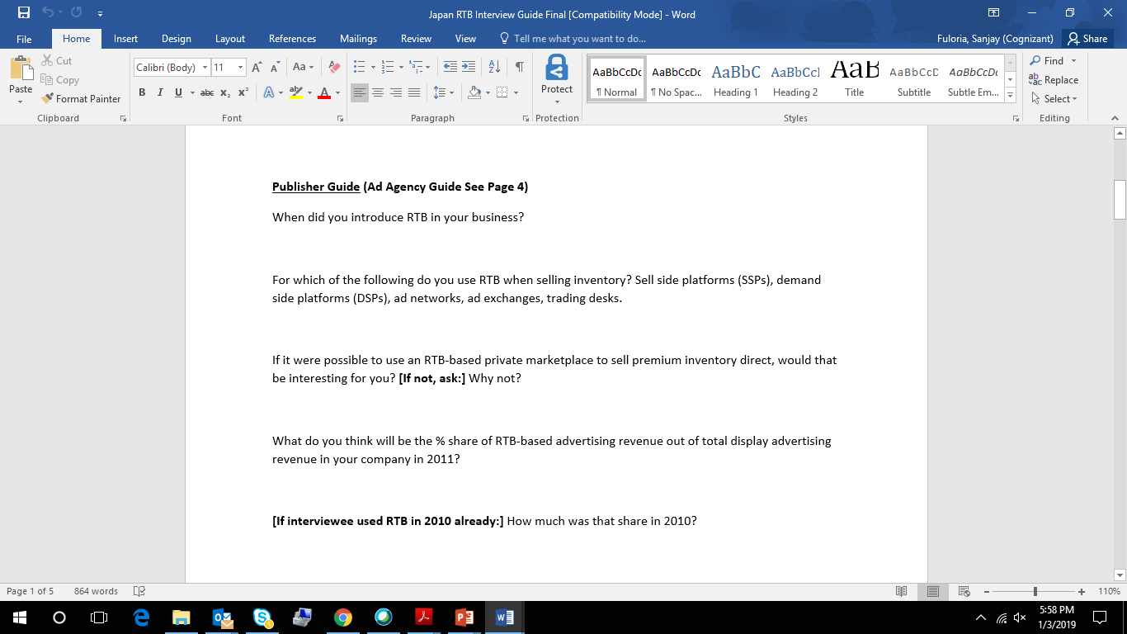
Interview Guide….

Slide 37
The Other Methods
Focus Groups
Mostly used in market research.
Only useful if you want to canvas opinion on one particular concept.
Field Notes
One classic example is Geography field trips.
Best used if you need to observe behaviour, collect samples etc.
Case Studies
An in depth analysis of something bearing close relation to your project. Very time consuming!

Slide 38
The Design Stage
Quantitative Data
Tick box/multiple choice questions
Answers are mostly pre-determined – you are testing existing theories and measuring responses
Think of sample sizes – who, how many and why
Qualitative Data
Open-ended and non-leading questions. Be flexible!
Dictaphone advisable – how they say it can be as important as what they say
BOTH
Do the questions you ask help you answer your research question?
Be sure to obtain consent and, if requested, assure anonymity

Slide 39
Communicating findings
Look for trends/anomalies
Compare with secondary research
Don’t just describe: analyse!
Relevance to research question

Slide 40
Analysis Techniques- Factor Analysis
Example-Cohesion
We have a concept of what “cohesion” is, but we can’t measure it directly.
Merriam-Webster:
the act or state of sticking together tightly
the quality or state of being made one
How do we measure it?
We cannot simply say “how cohesive is your team?” or “on a scale from 1-10, how do you rate your team cohesion?”
We think it combines several elements of “unity” and “team spirit” and perhaps other “factors”
Back

Slide 41
Factor Analysis
Data reduction tool
Removes redundancy or duplication from a set of correlated variables
Represents correlated variables with a smaller set of “derived” variables.
Factors are formed that are relatively independent of one another.
Two types of “variables”:
latent variables: factors
observed variables

Slide 42
Cohesion Variables:
G1 (I do not enjoy being a part of the social environment of this exercise group)
G2 (I am not going to miss the members of this exercise group when the program ends)
G3 (I am unhappy with my exercise group’s level of desire to exceed)
G4 (This exercise program does not give me enough opportunities to improve my personal performance)
G5 (For me, this exercise group has become one of the most important social groups to which I belong)
G6 (Our exercise group is united in trying to reach its goals for performance)
G7 (We all take responsibility for the performance by our exercise group)
G8 (I would like to continue interacting with some of the members of this exercise group after the program ends)
G9 (If members of our exercise group have problems in practice, everyone wants to help them)
G10 (Members of our exercise group do not freely discuss each athlete’s
responsibilities during practice)
G11 (I feel like I work harder during practice than other members of this exercise group)

Slide 43
Other examples
Diet
Air pollution
Personality
Customer satisfaction
Depression
Quality of Life

Slide 44
Some Applications of Factor Analysis
1. Identification of Underlying Factors:
clusters variables into homogeneous sets
creates new variables (i.e. factors)
allows us to gain insight to categories
2. Screening of Variables:
identifies groupings to allow us to select one variable to represent many
useful in regression (recall collinearity)
3. Summary:
Allows us to describe many variables using a few factors
4. Clustering of objects:
Helps us to put objects (people) into categories depending on their factor scores

Slide 45
Goals of Factor Analysis
One of the primary goals of factor analysis is often to identify a measurement model for a latent variable
This includes
identifying the items to include in the model
identifying how many ‘factors’ there are in the latent variable
identifying which items are “associated” with which factors

Slide 46
Example Output
------------------------------------
Variable | Factor1 Factor2 |
-------------+--------------------+
notenjoy | -0.3118 0.5870 |
notmiss | -0.3498 0.6155 |
desireexceed | -0.1919 0.8381 |
personalperf | -0.2269 0.7345 |
importants~l | 0.5682 -0.1748 |
groupunited | 0.8184 -0.1212 |
responsibi~y | 0.9233 -0.1968 |
interact | 0.6238 -0.2227 |
problemshelp | 0.8817 -0.2060 |
notdiscuss | -0.0308 0.4165 |
workharder | -0.1872 0.5647 |
-----------------------------------

Slide 47
How to interpret?
Loadings: represent correlations between item and factor
High loadings: define a factor
Low loadings: item does not “load” on factor
Easy to skim the loadings
This example:
factor 1 is defined by G5, G6,
G7, G8 G9
factor 2 is defined by G1, G2,
G3, G4, G10, G11
Other things to note:
factors are ‘independent’ (usually)
we need to ‘name’ factors
important to check their face validity.
These factors can now be ‘calculated’ using this model
Each person is assigned a factor score for each factor
Range between -1 to 1
------------------------------------
Variable | Factor1 Factor2 |
-------------+--------------------+
notenjoy | -0.3118 0.5870 |
notmiss | -0.3498 0.6155 |
desireexceed | -0.1919 0.8381 |
personalpe~m | -0.2269 0.7345 |
importants~l | 0.5682 -0.1748 |
groupunited | 0.8184 -0.1212 |
responsibi~y | 0.9233 -0.1968 |
interact | 0.6238 -0.2227 |
problemshelp | 0.8817 -0.2060 |
notdiscuss | -0.0308 0.4165 |
workharder | -0.1872 0.5647 |
-----------------------------------
High loadings are highlighted
in yellow.

Slide 48
How to interpret….
------------------------------------
Variable | Factor1 Factor2 |
-------------+--------------------+
notenjoy | -0.3118 0.5870 |
notmiss | -0.3498 0.6155 |
desireexceed | -0.1919 0.8381 |
personalpe~m | -0.2269 0.7345 |
importants~l | 0.5682 -0.1748 |
groupunited | 0.8184 -0.1212 |
responsibi~y | 0.9233 -0.1968 |
interact | 0.6238 -0.2227 |
problemshelp | 0.8817 -0.2060 |
notdiscuss | -0.0308 0.4165 |
workharder | -0.1872 0.5647 |
-----------------------------------
Authors may conclude something like:
“We were able to derive two factors from the 11 items. The first factor is defined as “teamwork.” The second factor is defined as “personal competitive nature .” These two factors describe 72% of the variance among the items.”
High loadings are highlighted
in yellow.

Slide 49
Multi-Factor Models
Two factor orthogonal model
ORTHOGONAL = INDEPENDENT
Example: cohesion has two domains
X₁ = λ₁₁F₁ + λ₁₂F₂ + e₁
X2 = λ21F1 + λ22F2 + e2
X₁₁ = λ₁₁₁F₁ + λ₁₁₂F₂ + e₁₁
More generally, m factors, n observed variables
X₁ = λ₁₁F₁ + λ₁₂F₂ +…+ λ_{1m}F_{m} + e₁
X₂ = λ₂₁F₁ + λ₂₂F₂ +…+ λ_{2m}F_{m} + e₂
X_{n} = λ_{n1}F₁ + λ_{n2}F₂ +…+ λ_{nm}F_{m} + e_{n}

Slide 50
Data Matrix
Factor analysis is totally dependent on correlations between variables.
Factor analysis summarizes correlation structure
v₁……...v_{k}
v₁……...v_{k}
F₁…..F_{j}
O₁
.
.
.
.
.
.
.
.
O_{n}
v₁
.
.
.
v_{k}
v₁
.
.
.
v_{k}
Correlation
Matrix
Factor
Matrix
Data Matrix
Implications for assumptions about X’s?

Slide 51
Choosing Number of Factors
Intuitively: The number of uncorrelated constructs that are jointly measured by the X’s.
Only useful if number of factors is less than number of X’s (recall “data reduction”).
Use “principal components” to help decide
type of factor analysis
number of factors is equivalent to number of variables
each factor is a weighted combination of the input variables:
F₁ = a₁₁X₁ + a₁₂X₂ + ….
Recall: For a factor analysis, generally,
X₁ = a₁₁F₁ + a₁₂F₂ +...

Slide 52
Eigenvalues
To select how many factors to use, consider eigenvalues from a principal components analysis
Two interpretations:
eigenvalue ≅ equivalent number of variables which the factor represents
eigenvalue ≅ amount of variance in the data described by the factor.
Rules to go by:
number of eigenvalues > 1
scree plot
% variance explained
comprehensibility
Note: sum of eigenvalues is equal to the number of items

Slide 53
Scree Plot for Cohesion Example

Slide 54
Choose two factors: Now fit the model
-------------------------------------------------
Variable | Factor1 Factor2 | Uniqueness
-------------+--------------------+--------------
notenjoy | -0.6091 0.2661 | 0.5582
notmiss | -0.6566 0.2648 | 0.4988
desireexceed | -0.6712 0.5373 | 0.2608
personalpe~m | -0.6342 0.4344 | 0.4091
importants~l | 0.5538 0.2162 | 0.6466
groupunited | 0.7164 0.4137 | 0.3156
responsibi~y | 0.8456 0.4197 | 0.1088
interact | 0.6271 0.2132 | 0.5613
problemshelp | 0.8187 0.3866 | 0.1802
notdiscuss | -0.2830 0.3072 | 0.8256
workharder | -0.4977 0.3260 | 0.6461
-------------------------------------------------

Slide 55
Interpretability?
Not interpretable at this stage
In an unrotated solution, the first factor describes most of variability.
Ideally we want to
spread variability more evenly among factors.
make factors interpretable
To do this we “rotate” factors:
redefine factors such that loadings on various factors tend to be very high (-1 or 1) or very low (0)
intuitively, it makes sharper distinctions in the meanings of the factors
We use “factor analysis” for rotation NOT principal components!
Rotation does NOT improve fit!

Slide 56

Rotating Factors (Intuitively)
F2
F2
3
2
1
3
2
1
F1
4
4
F1
Factor 1 Factor 2
x1 0.5 0.5
x2 0.8 0.8
x3 -0.7 0.7
x4 -0.5 -0.5
Factor 1 Factor 2
x1 0 0.6
x2 0 0.9
x3 -0.9 0
x4 0 -0.9

Slide 57
Factor Scores and Scales
Each object (e.g. each cancer survivor) gets a factor score for each factor.
Old data vs. New data
The factors themselves are variables
An individual’s score is weighted combination of scores on input variables
These weights are NOT the factor loadings!
Loadings and weights determined simultaneously so that there is no correlation between resulting factors.

Slide 58
Digital Footprint Index using PCA

Slide 59
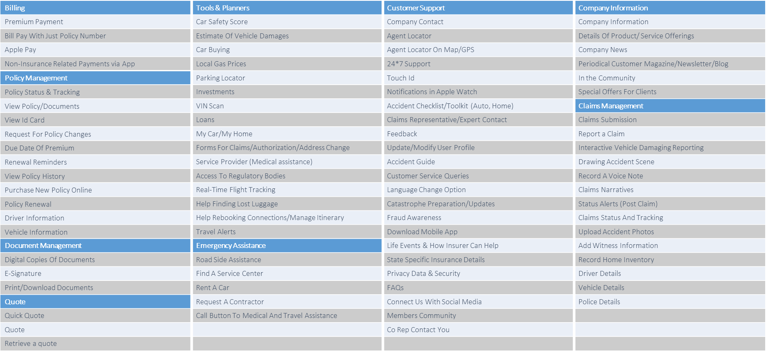
Feature Areas & Functionalities

Slide 60
Q4 ‘18 Digital Footprint Index Scores
Mobile Index Score
860
Customer Portal Index Score
1491
Mobile-First Index Score
631
Mobile-First Index Score is the difference between the Mobile Index Score and the Customer Portal Index Score

Slide 62
Mobile and Web Index Score Q/Q Change
As it is evident from the Q/Q index score trend lines, web index has increased rapidly in Q1’ 16 outpacing mobile index.
In Q1’16, the mobile first index gap has increased more than previous quarters.

Slide 63

Thank You
Sanjay Fuloria

